Slide 1

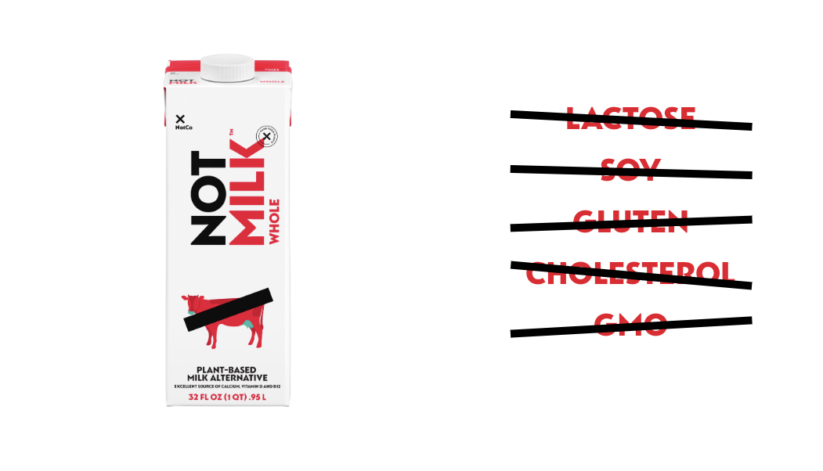
Team G2

Slide 2





Introducing the Team
Hezekiah
Yi-Kai
Erina
Rachana
Introduction
Why Germany?
Market analysis
Risk and Mitigation
Financials
Conclusion

Slide 3
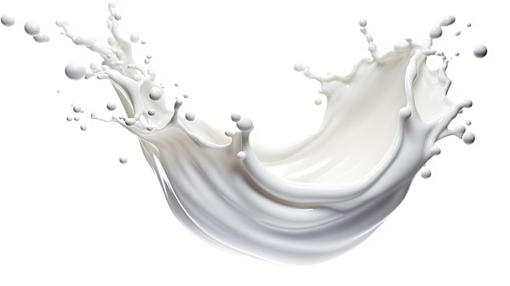
Why Germany is our target market?
Biggest European Milk Consumption
#1 in Total Milk Revenue
out of three European Countries
with the highest GDP
Germany
UK
France
Introduction
Why Germany?
Market analysis
Risk and Mitigation
Financials
Conclusion

Slide 4
Why Germany is our target market?
Milk Substitute market is expected to grow up to 12% in average every year

Slide 5
Why Germany is our target market?
More than 40% of people in Germany are moving towards
plant-based/Lactose free diets.

Slide 6
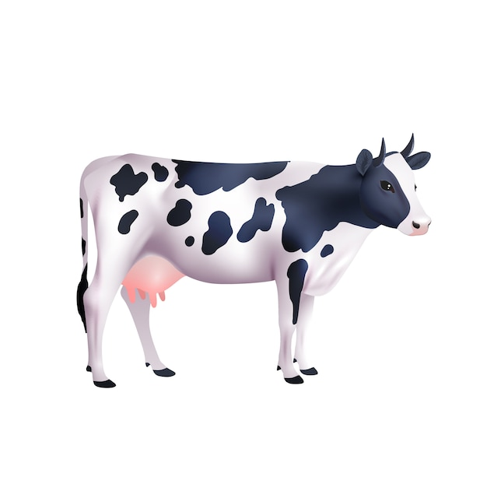
Why Germany is our target market?
Growth in Milk Substitutes Industry
Decrease in Fluid Milk Consumption by the price increase
Due to
Cow Population
Decrease

Slide 7
Market Overview
Market Overview
2023 – 2028 Food Market Prediction
$ 238.10 Billion
TAM of Food Market in Germany At a compound annual growth rate (CAGR) by 3.94%
Total Addressable Market
$ 6.58 Billion
SAM : Total Milk Market in Germany
$ 0.46 Billion
Target Market : 32% of current milk consumers are likely to prefer milk substitutes
Service Addressable Market
Target Market
Introduction
Why Germany?
Market analysis
Risk and Mitigation
Financials
Conclusion

Slide 8
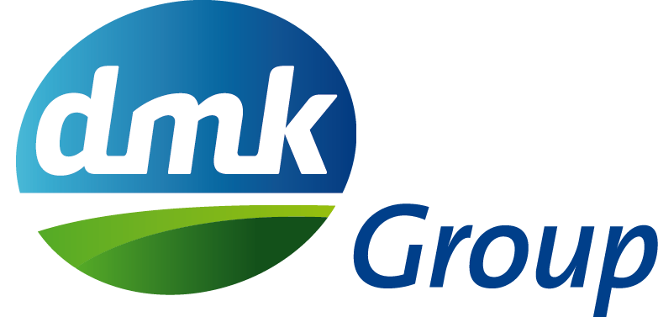
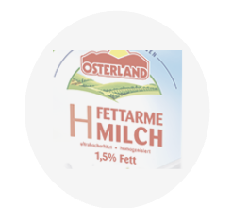
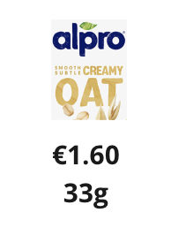
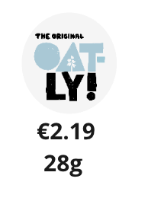

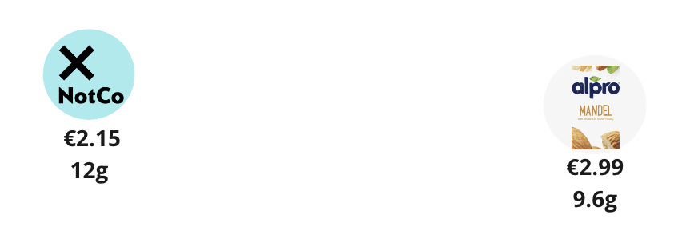
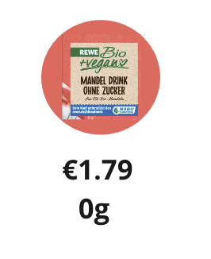
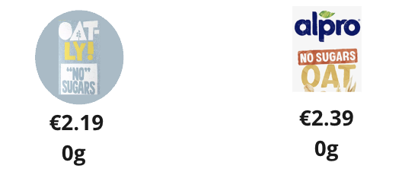
Positioning
HIGH SUGAR
UNIT : 1L
NotMilk is in the
MIDDLE of every scale
Price
Oat < Fluid Milk < NotMilk
< Sugar-Free < Almond
Sugar
Sugar-Free < Almond < NotMilk < Oat < Fluid Milk
Є1.95 56g
Є1.09 49g
LOW PRICE
HIGH PRICE
LOW SUGAR

Slide 9
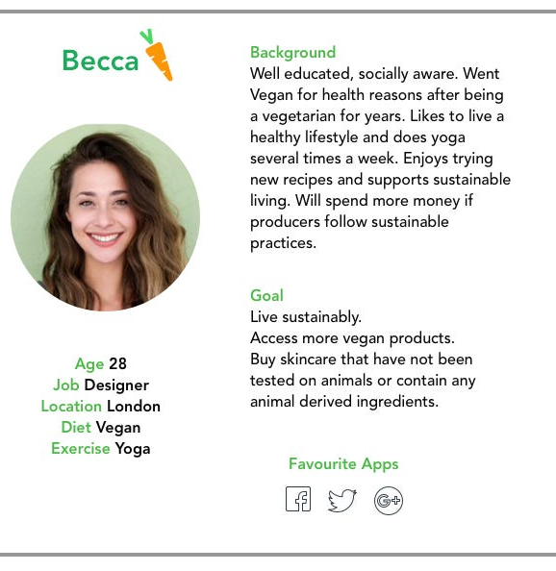




Customer Persona
Target Group
Ages 18 – 34
German Customer Behavior
Value quality over price
Environmentalists
Health conscious
Germany

Slide 10
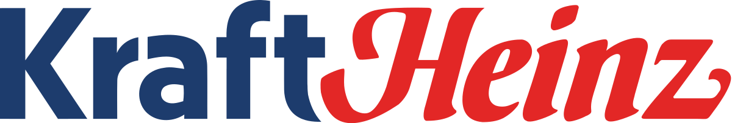
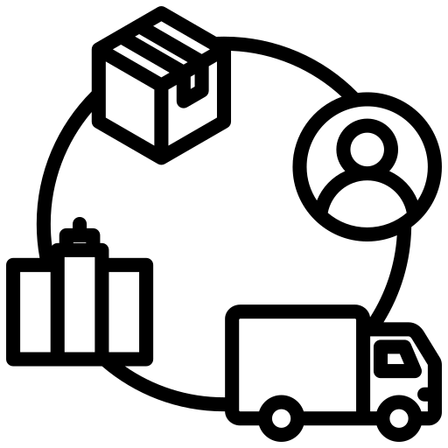


Collaborators
Key Partner
Leverage existing distribution channels
Use existing manufacturing plant in Netherlands
Room for improvement in the social media space

Slide 11
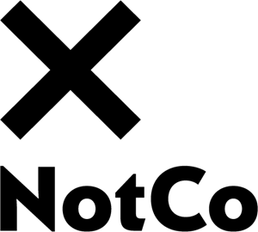

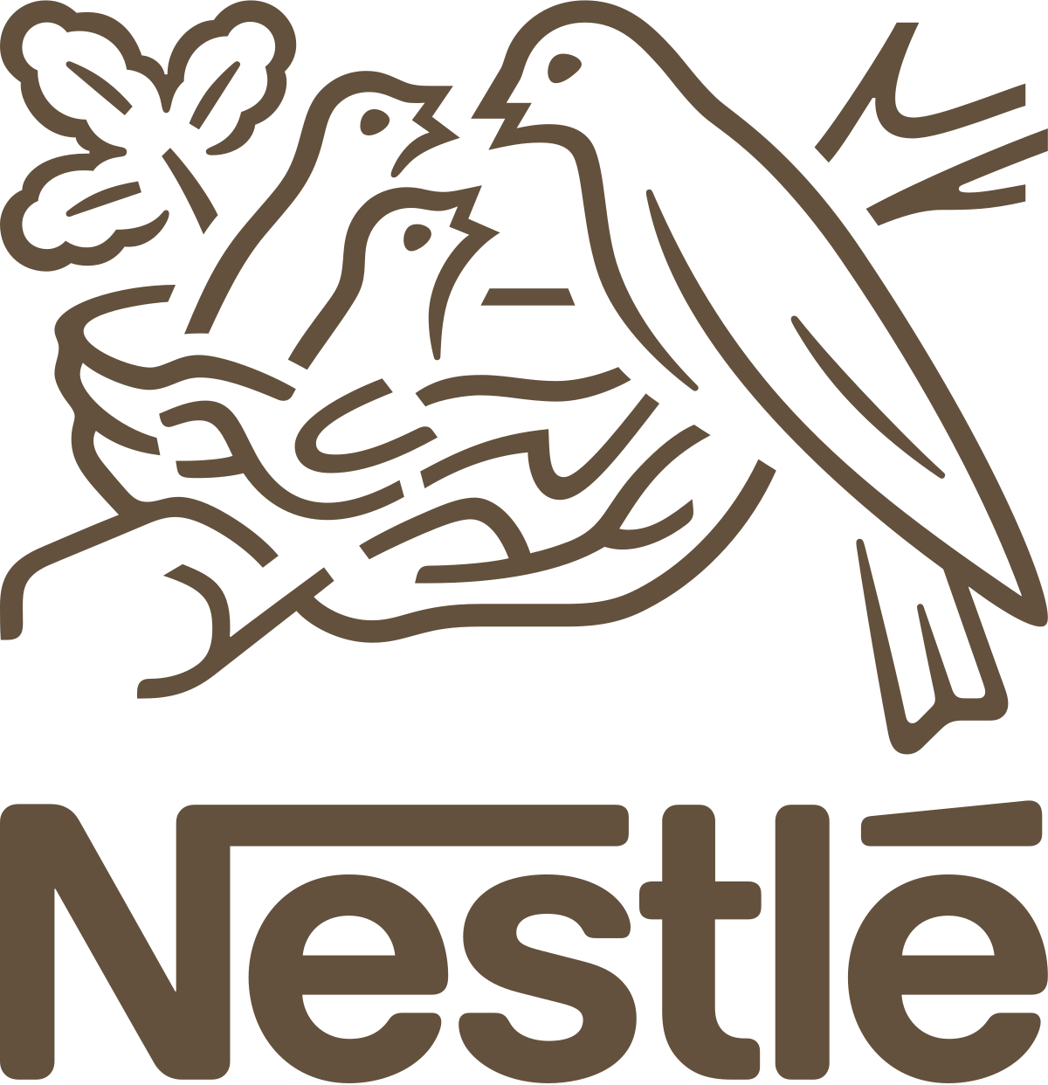


 | Technology | Price | Sustainability | Nutrition
Competitors
Milk Consumers
35%
Plant-based milk drinkers
65%
Regular milk drinkers

Slide 12


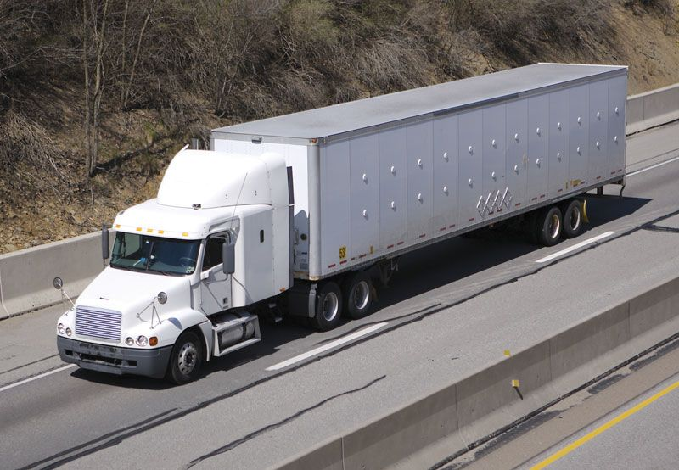
Context
Taxation
19%
Market trends
Technology
Trends towards health
awareness and sustainability
Leveraging technology to create new flavours and identify marketing opportunities
Regulations
Quality Control
‘Plant based drinks’ and
not ‘Milk alternatives’
Strict food regulations

Slide 13




Marketing in Germany
42.1 MINUTES/DAY
101 MINUTES/DAY
Average time spent in commute using public transport
Average time spent using social media
$ 127.03 M
$ 27.59 B
Estimated total social media Ad spending
Estimated total physical media Ad spending

Slide 14
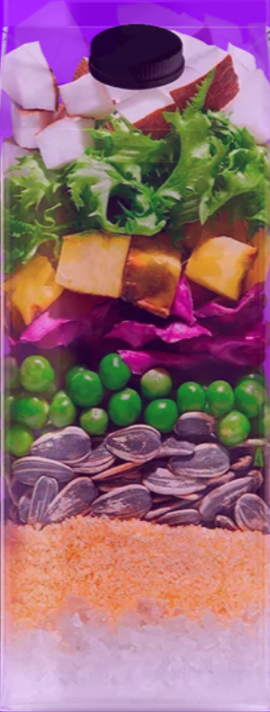
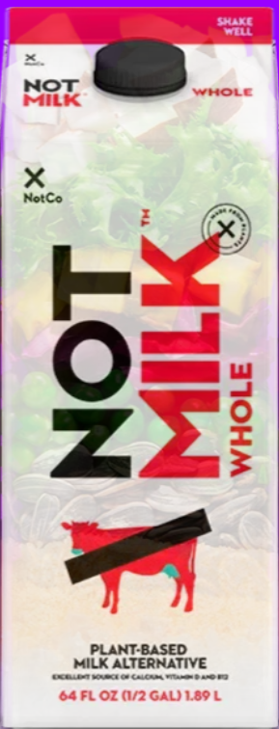
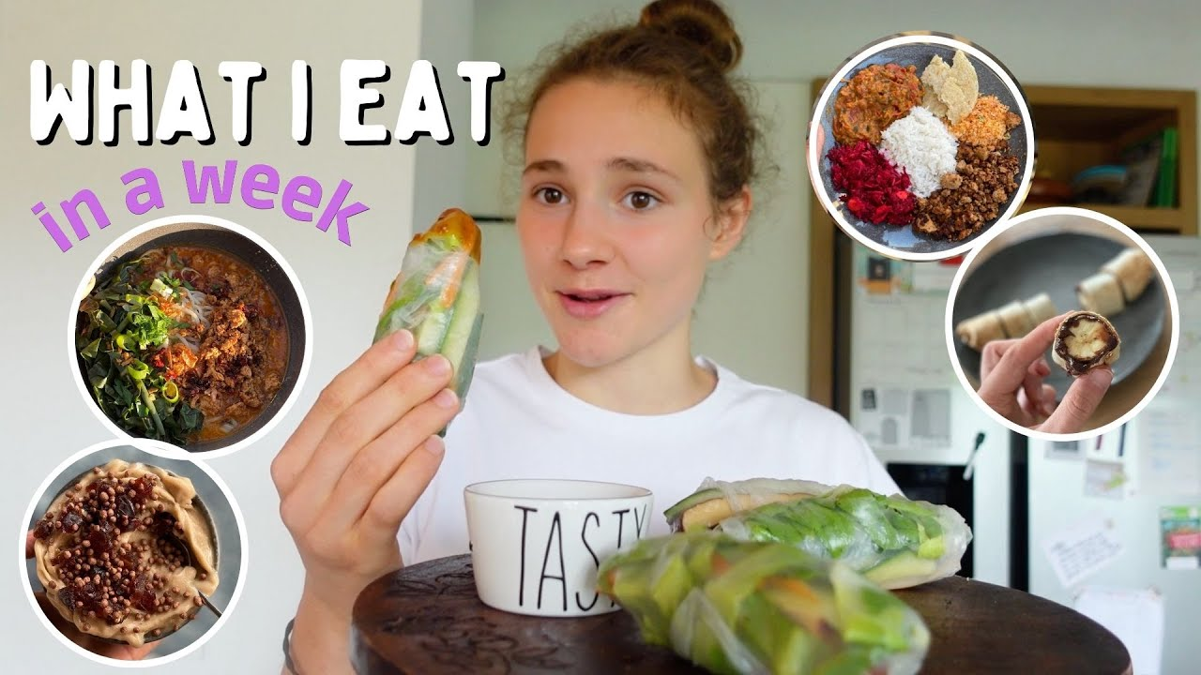
Social Media Marketing
Educational content
about AI, environment and sustainability
Social media
Engagement campaigns, recipe tests, challenges

Slide 15
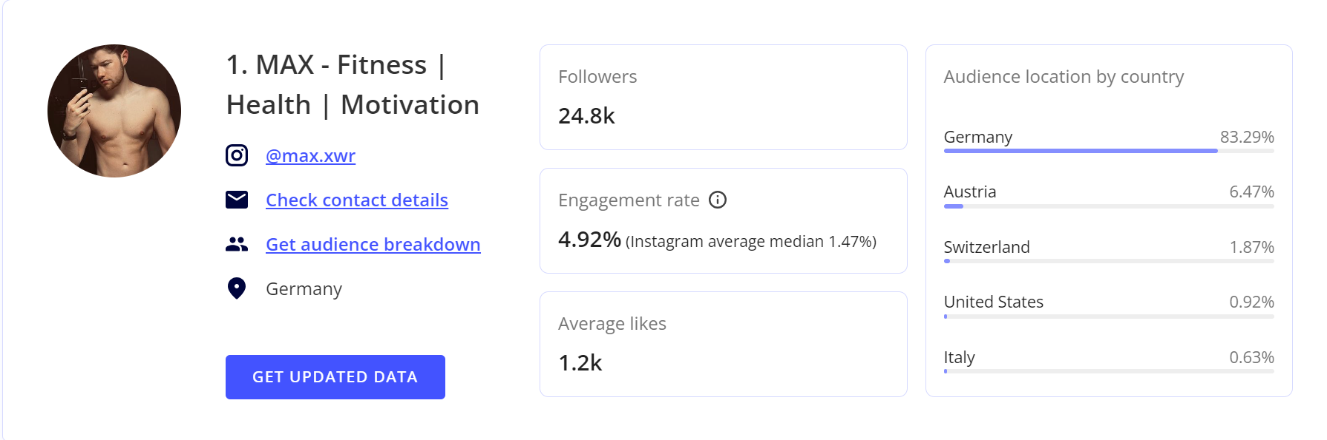
Social Media Marketing
Influencer partnerships
Get fitness influencers with good reach in Germany to use and market NotMilk’s products

Slide 16

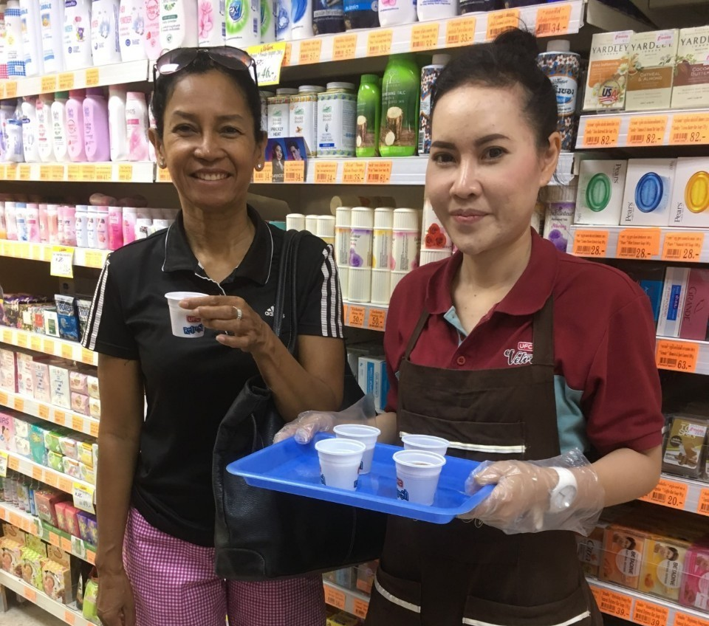
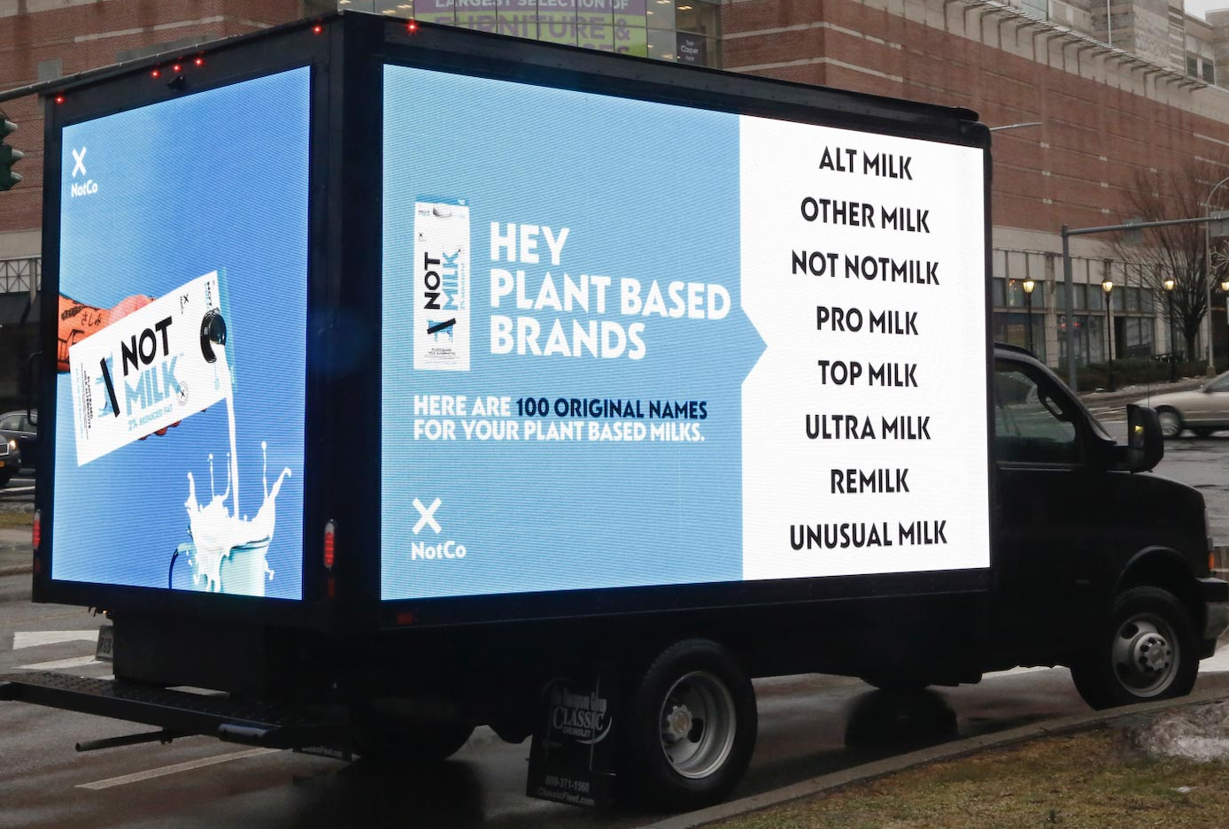
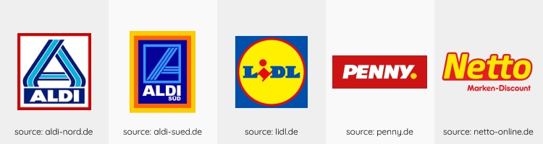
Physical Marketing
Posters on buses and train stations
Partnerships with cafes and restaurants
Partnerships with grocery chains as well as in store promotions like sampling

Slide 17



Risk and mitigation
Price higher than oat milk
Crowded market
Emphasize on quality and unique selling point
- Ads in public transportation
- SEO
Brand Awareness
- International Trade Fairs
Introduction
Why Germany?
Market analysis
Risk and Mitigation
Financials
Conclusion

Slide 18
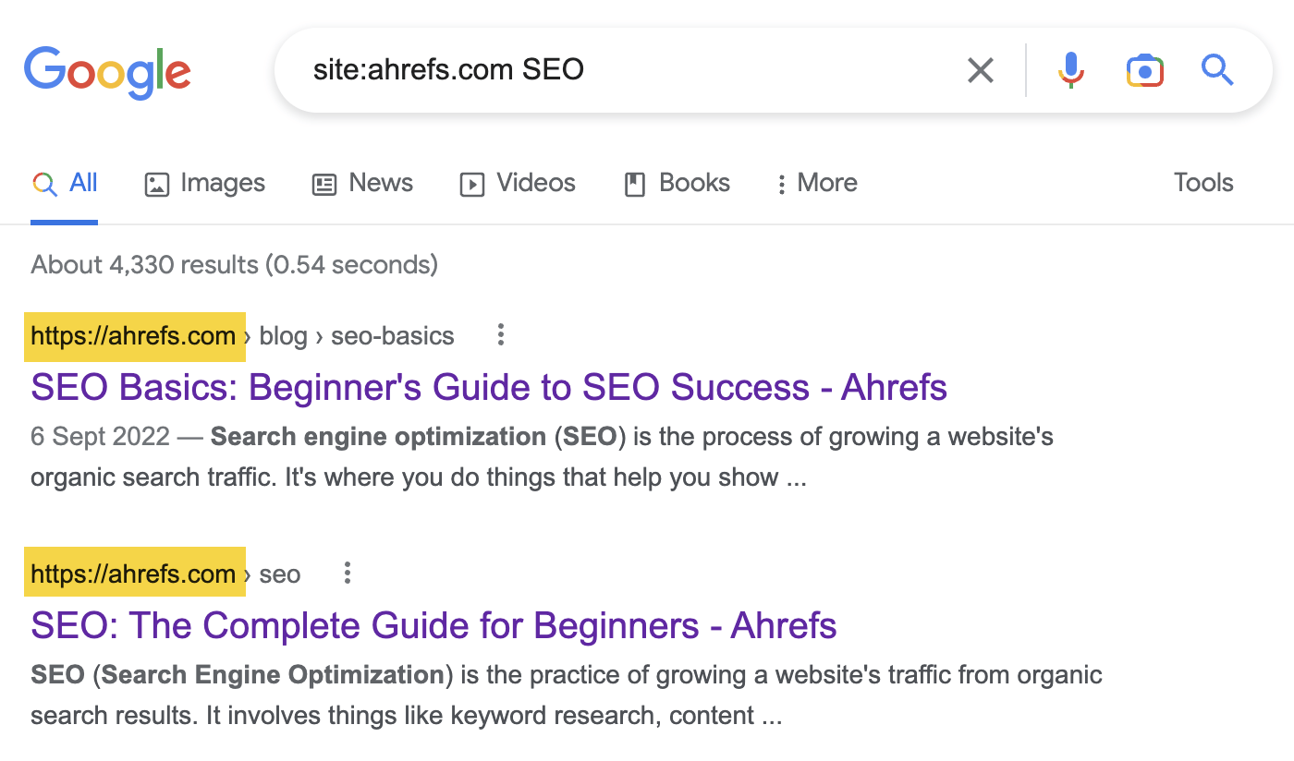
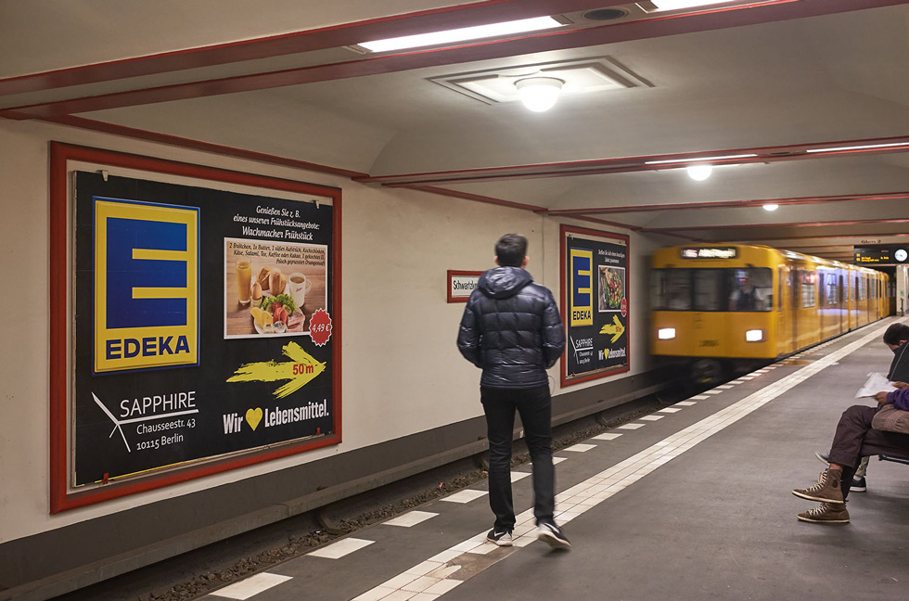
Mitigation methods
AI, machine learning
keyword SEO
Ads in metro station

Slide 19


Risk and mitigation
Ethical issues in AI
Regulation risk
Education
- Interactive website demo of algorithm
Partnership
- International Trade Administration

Slide 20

Partnership with International Trade Administration

Slide 21

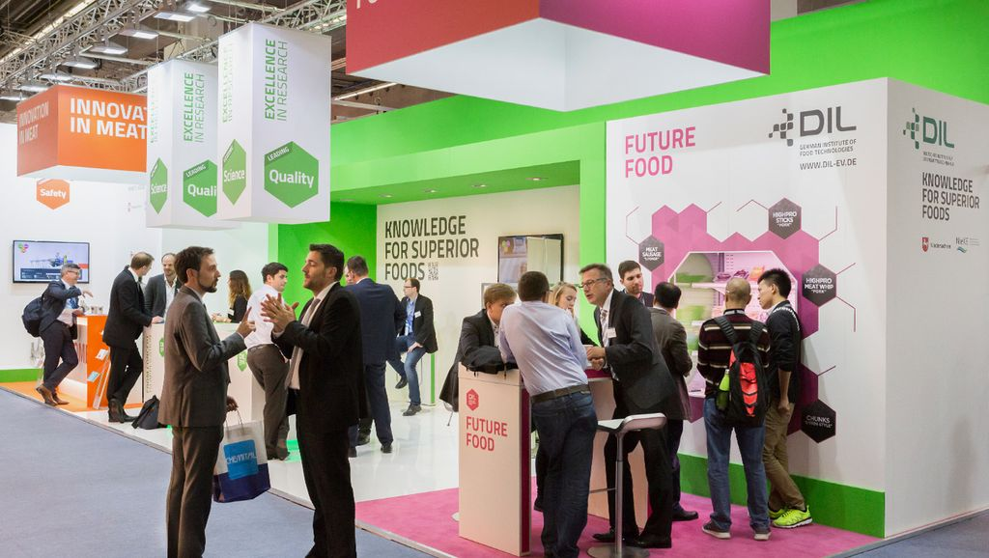


International Trade Fairs
Participate in trade fair
with low cost
Iteration
Customer feedback
Sentiment Analysis

Slide 22
Distribution Cycle
NotCo x Kraft Heinz
NotCo
Kraft Heinz
Distributors
German
Consumers
Retailers
Produce NotMilk in Netherlands
QA and Create Labels
Ship Product
to Retailers
Stock NotMilk
on Shelves
Buy NotMilk
Introduction
Why Germany?
Market analysis
Risk and Mitigation
Financials
Conclusion

Slide 23
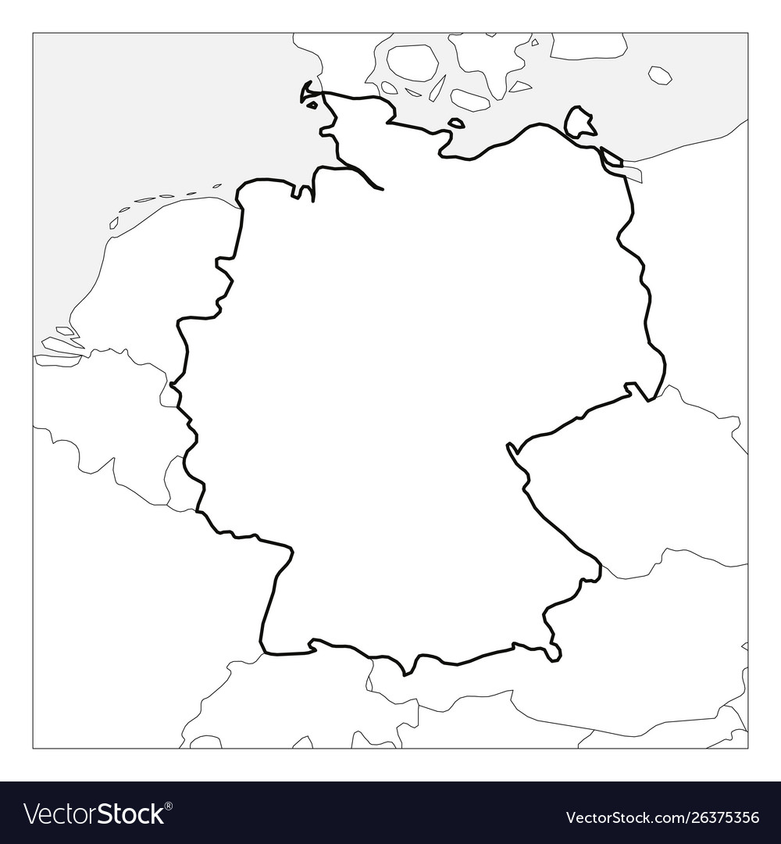

Implementation
Kraft Heinz Center
Amsterdam, NL
Hamburg
• Population: 1.84 M
• Age 18-35: 0.65 M
Berlin
• Population: 3.65 M
• Age 18-35 : 1.15 M
Munich
• Population: 1.47 M
• Age 18-35: 0.56 M

Slide 24
Profit Potential
For 1 Million Units
$1.2M
Total Profit
Expenses
Retail Price per Unit
$920,000
$2.15
Revenues
$2,150,000

Slide 25

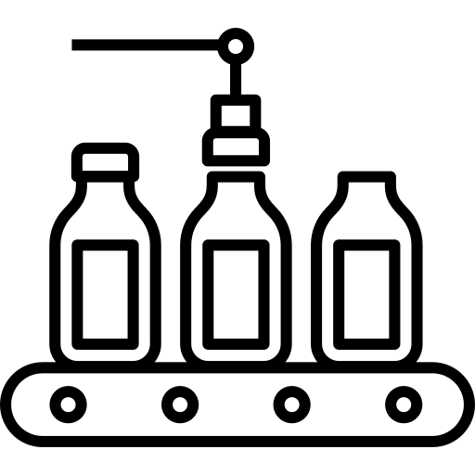

Break-Even Analysis
Marketing
$225K
Production
$920K
Total Expenses:
$1,145,000
Break-Even Point for Sales:
535,000 Units

Slide 26



Conclusion
Target
Customers
Positioning
Marketing
Germany Ages 18 – 34
Environmentalists
Health conscious
Lower Sugar than Oat Milk and Fluid Milk
Cheaper than Almond Milk Middle Price in the Milk Industry
Public Transportation Health Influencer Social Media Partnership with Bio Supermarkets
Cost
$1.145 M
Net Profit
$ 1.2M
Introduction
Why Germany?
Market analysis
Risk and Mitigation
Financials
Conclusion

Slide 27
Appendix
Ingredients Cost Breakout
Packaging Specifications
Transportation Cost
Break Even Calculations
Coffee Consumption
German Customer Insights
Possible Grocery Partners
Major Milk Companies
European countries GDP
More supermarkets than online
Flexitarians
Germany Food Market Size
Sales Price & Nutrition Origin
Metrics for mitigation plan
Target market calculation
Notco Company Analysis
SWOT Analysis
Demand calculation
German population distribution
International trade fair
Financials

Slide 28
Company
Strengths:
Fewer calories
Dairy-Free
Extended shelf life
Weakness of NotMilk:
Protein value lower than regular milk
Higher cost than oat milk
Notes:
This AI generated recipe contains fewer calories and less sugar. It is closest in taste to actual milk

Slide 29
Metrics
Brand Awareness
- International Trade Fairs:
(1) Conversion rate of fair visitors
(2) Customer acquisition cost
(3) ROI per trade fair
(4) Month over month growth rate of customer feedback number
- Viral marketing
(1) Click through rate
(2) Month over month growth rate of participant number
- Word of mouth
(1) Customer Referral Rate

Slide 30
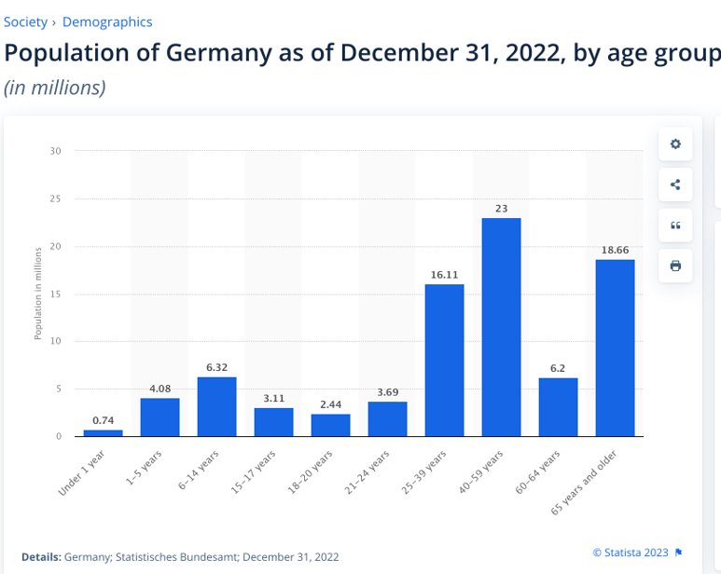
Target market calculation
$ 6.58billion (Total milk market) x 0.32(potential churn) x 0.22(target age 18~40 years old)

Slide 31
Demand calculation
$ 0.46 billion(target market size) / 2.46 euro per liter = 250,000 liter

Slide 32
SWOT Analysis
Strengths
Weaknesses
Health benefits and sustainability
Dairy free (for vegans/ flexitarians)
3g Sugar per serving vs 7g per serving of oatmilk
Best taste substitute
Long shelf life (treating regular milk as competitor)
Cost
Lower protein content compared to regular milk but equivalent to other plant-based alternatives
Additives and preservatives
Opportunity
Threats
Growing market
Partnerships
Product innovation
Health and wellness trends
Competition: Oatmilk is the largest consumed plant based alternative
Laws and regulations: may be seen as Negative marketing of milk
Trust in AI

Slide 33
German population distribution

Slide 34
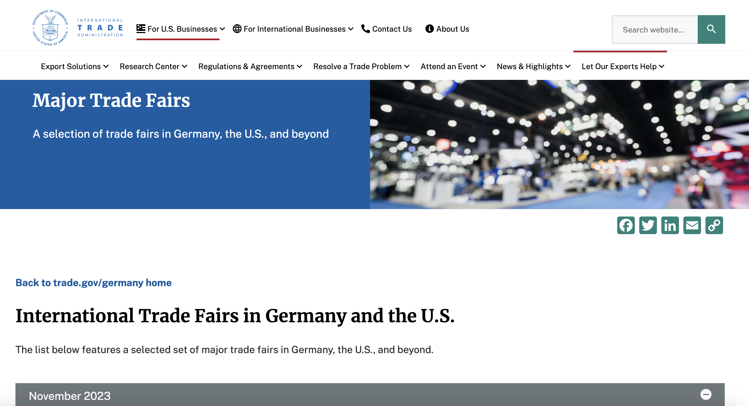
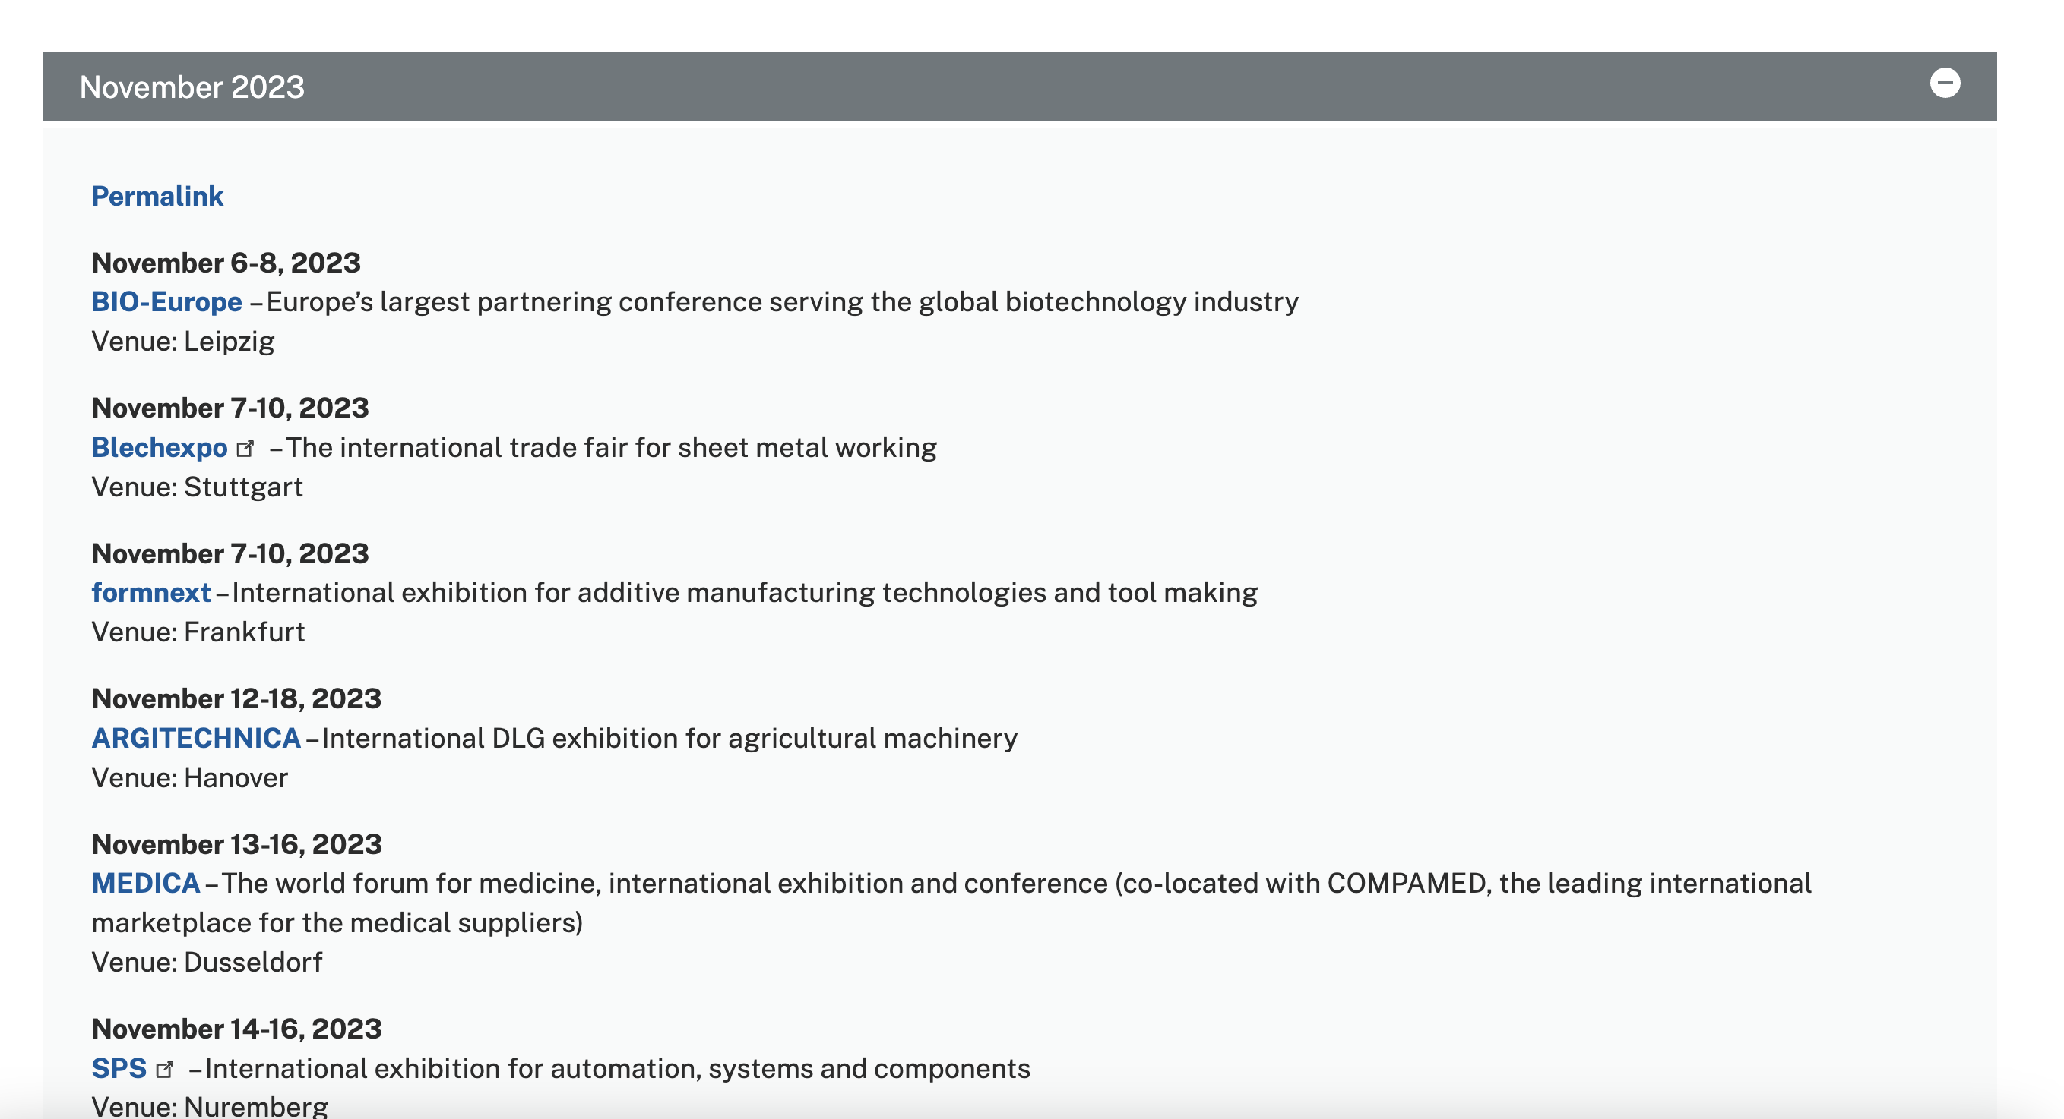
International trade fair
https://www.trade.gov/german-trade-fairs

Slide 35
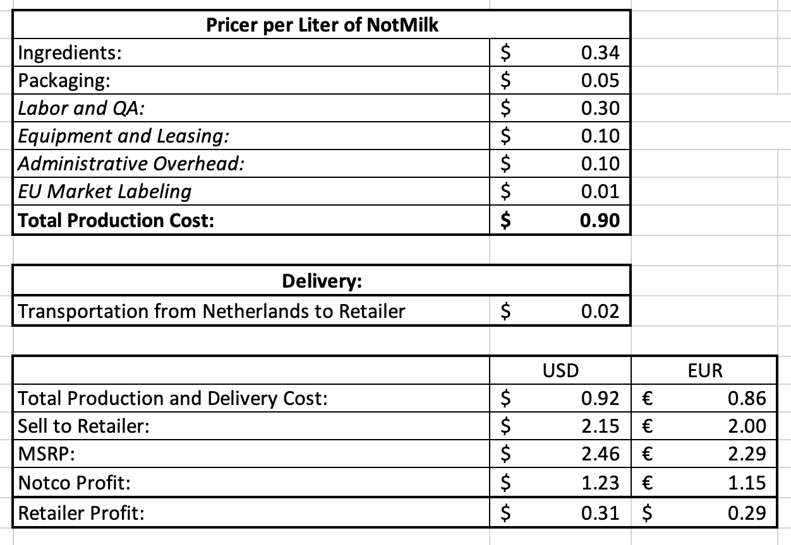
Financials
Notco Margin | 134%
Retailer Margin: | 14%

Slide 36
Ingredients Cost Breakout
1.9 L of Notmilk | Percent of Formula: | L of Ingredient: | mL of Ingredient: | Cost of Ingredients per mL: | Cost per 1.9L | Cost for 1,000,000 units
Main Ingredients: | 98%
Water | 0.9 | 1.71 | 1710 | $ 0.0000008 | $ 0.001368000 | $ 1,368.00
Sunflower Oil | 0.05 | 0.095 | 95 | $ 0.0010845 | $ 0.103024353 | $ 103,024.35
Pea Protein | 0.03 | 0.057 | 57 | $ 0.0060000 | $ 0.342000000 | $ 342,000.00
Contains less than 2% of: | 2.0%
Sugar | 0.199% | 0.00378 | 3.78 | $ 0.0009300 | $ 0.003516330 | $ 3,516.33
Pineapple Juice Concentrate | 0.199% | 0.00378 | 3.78 | $ 0.0060760 | $ 0.022973205 | $ 22,973.21
Dipotassium Phosphate | 0.199% | 0.00378 | 3.78 | $ 0.0012611 | $ 0.004768109 | $ 4,768.11
Calcium Carbonate | 0.199% | 0.00378 | 3.78 | $ 0.0005000 | $ 0.001890500 | $ 1,890.50
Gellan Gum | 0.199% | 0.00378 | 3.78 | $ 0.0230000 | $ 0.086963000 | $ 86,963.00
Acacia Gum | 0.199% | 0.00378 | 3.78 | $ 0.0068000 | $ 0.025710800 | $ 25,710.80
Salt | 0.199% | 0.00378 | 3.78 | $ 0.0000200 | $ 0.000075620 | $ 75.62
Monocalcium Phosphate | 0.199% | 0.00378 | 3.78 | $ 0.0005000 | $ 0.001890500 | $ 1,890.50
Natural Flavor | 0.199% | 0.00378 | 3.78 | $ 0.0050000 | $ 0.018905000 | $ 18,905.00
Cabbage Juice Concentrate | 0.199% | 0.00378 | 3.78 | $ 0.0075000 | $ 0.028357500 | $ 28,357.50
Vitamin D2 | 0.000242% | 0.0000046 | 0.0046 | $ 0.0160000 | $ 0.000073600 | $ 73.60
Vitamin B12 | 0.000042% | 0.0000008 | 0.0008 | $ 1.7328000 | $ 0.001386240 | $ 1,386.24
Totals | 99.990% | 1.8998154 | 1899.8154 | 1.807472298 | $ 0.64 | $ 642,902.76

Slide 37
Packaging Specifications
Packaging Type Description: | Case | Outer Case Length: | 230 mm
Total Quantity of Inner Units in Outer Case: | 6 Unit | Outer Case Width: | 160 mm
Is Trade Item Splittable?: | No | Outer Case Height: | 220 mm
 |  | Product Gross Weight: | 6.50 kg
Pallet Information |  | Product Net Weight: | 6.20 kg
Quantity of Cases Per Pallet Layer: | 31 Cases
Quantity of Layers Per Pallet : | 5 Layers | Pallet Height: | 1.26 | Meter
Quantity of Cases Per Pallet: | 155 Cases | Pallet Gross Weight: | 1.8 | Kg
Logistical Information
Shelf Life from Time of Production: | 365 Days
Guaranteed Shelf Life on Delivery : | Not specified. | Minimum Order Quantity: | Not specified.
 |  | Delivery Lead Time: | Not specified.

Slide 38
Shipping Specifications
Quantity of Cases Per Pallet Layer: | 31 | Cases
Quantity of Layers Per Pallet : | 9 | Layers
Quantity of Cases Per Pallet: | 279 | Cases
Quantity of Cartons per Pallet: | 1674
Empty Palet Height: | 0.16 | Meters
Outer Case Length: | 230 | mm | 0.23 | Meters
Outer Case Width: | 160 | mm | 0.16 | Meters
Outer Case Height: | 220 | mm | 0.22 | Meters
Product Gross Weight: | 6.5 | kg
Product Net Weight: | 6.2 | kg
Empty Palet Height:
Area of 1 case: | 0.0368 | Meters Squared
Area of 1 palet: | 1.1408 | Meters Squared
Height of 1 Palet: | 2.14 | Meters

Slide 39
Transportation Cost Calculations
Cost to ship one 40-foot container from NL to Berlin: | $1,000
# of units that can fit on 40-foot container: | 40,176
Cost per unit | $0.02

Slide 40
Break-Even Point Calculations
Net Cost | 1,145,000.00
Revenue per Sale: | 2.15
Net Cost / Revenue: | 532,558.14
Round up: | 535,000

Slide 41
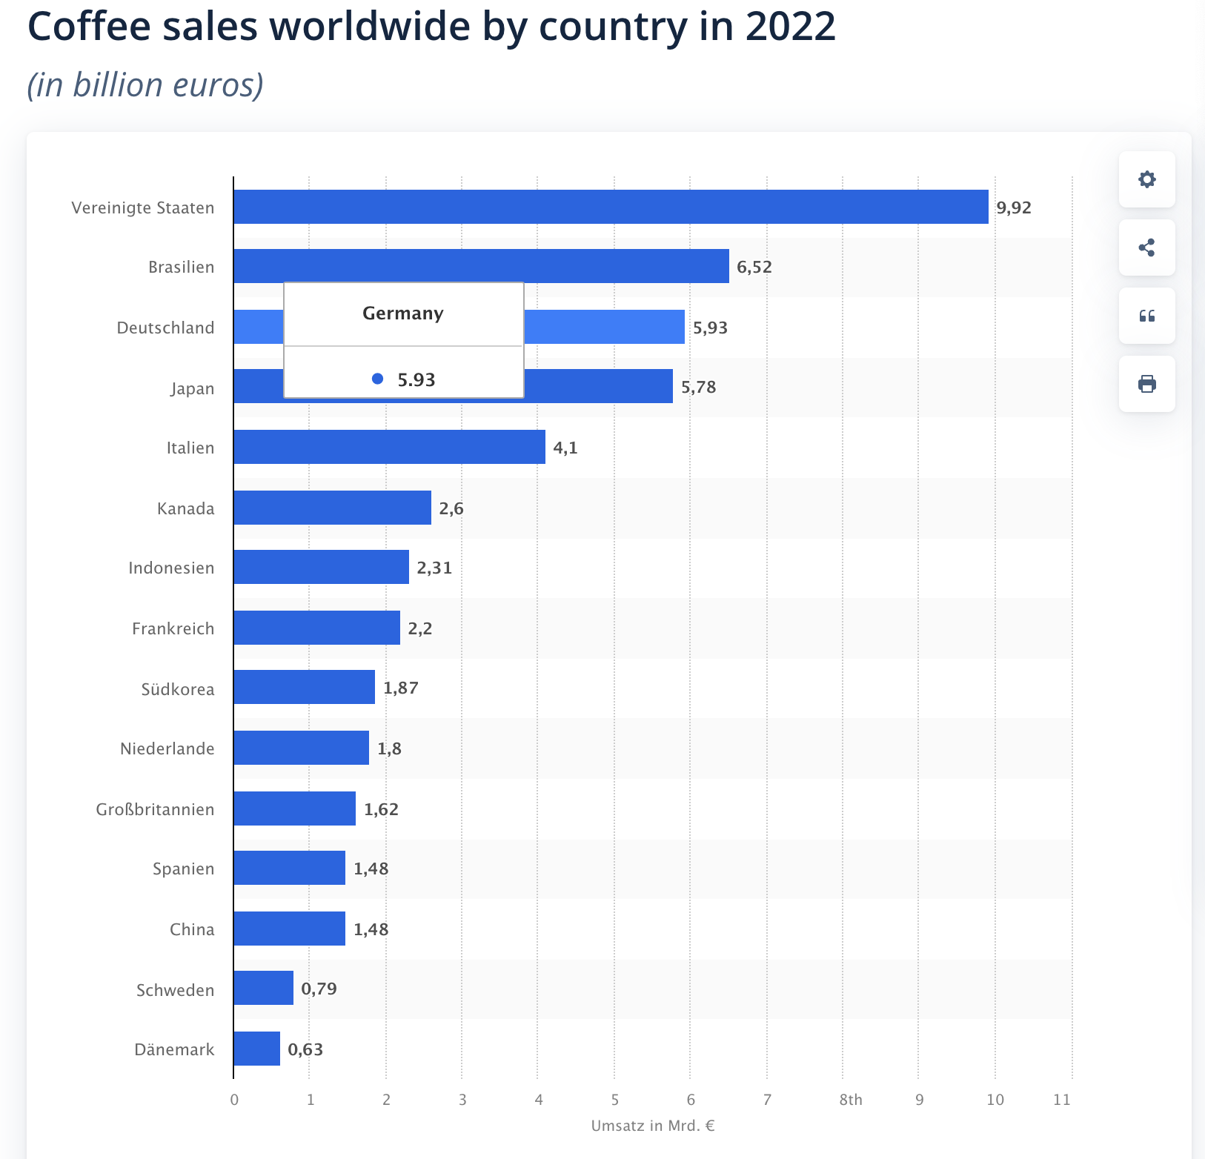
Coffee Consumption

Slide 42
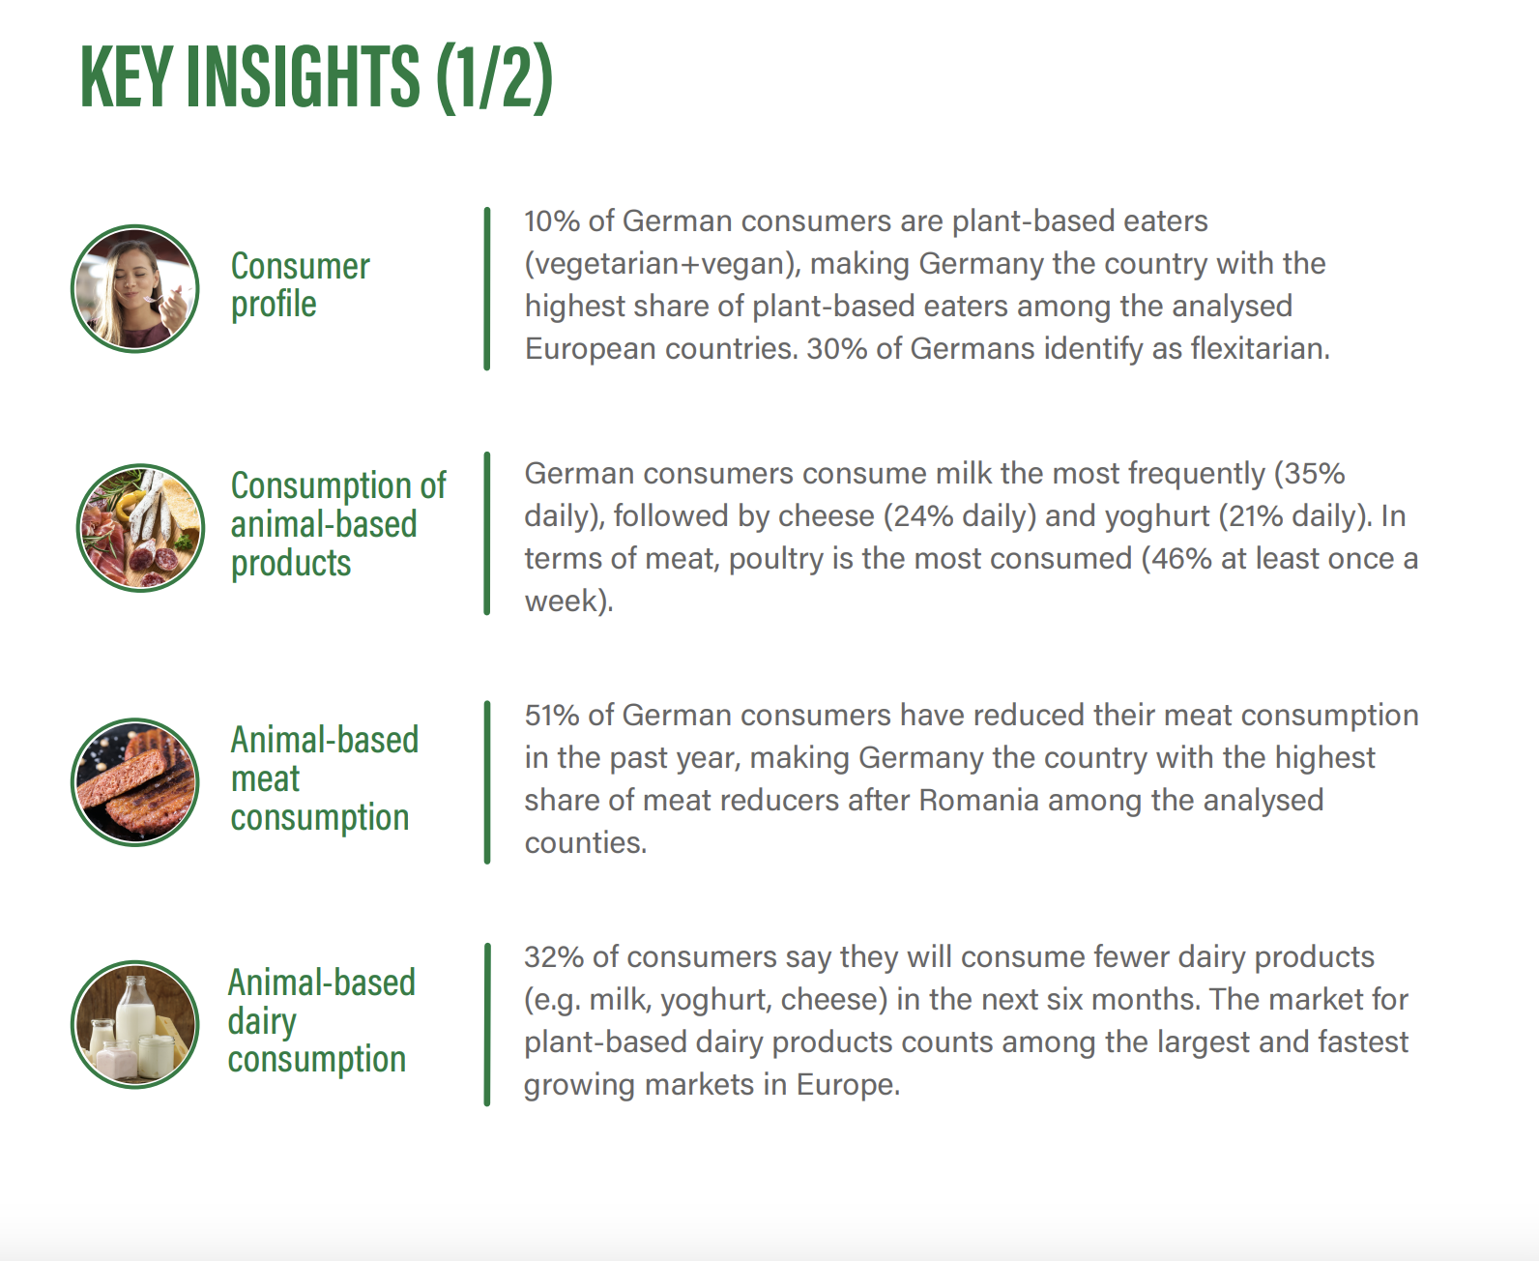
Customer Insights
ProVeg International is a food awareness organization working to transform the global food system by replacing 50% of animal products globally with plant-based and cultivated foods by 2040
https://corporate.proveg.com/wp-content/uploads/2022/05/Report-Plant-based-food-in-Germany-1.pdf

Slide 43
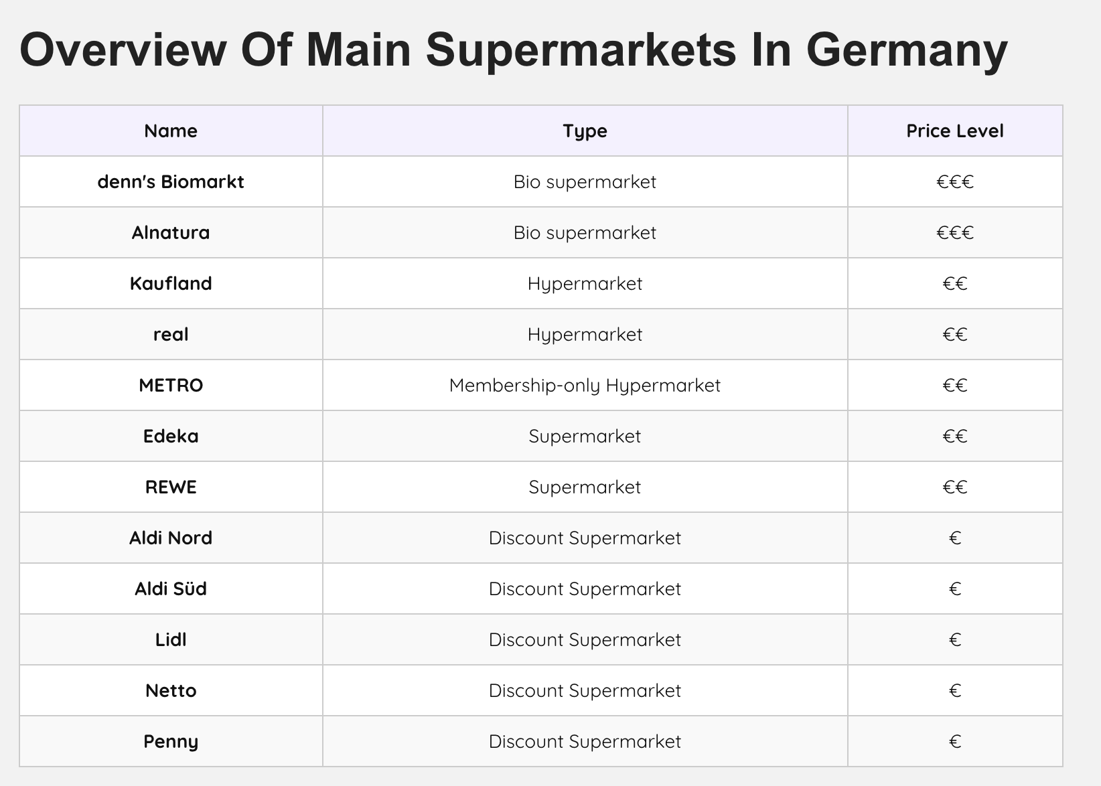
Possible Grocery Partners
Main Target :
Discount SuperMarkets

Slide 44
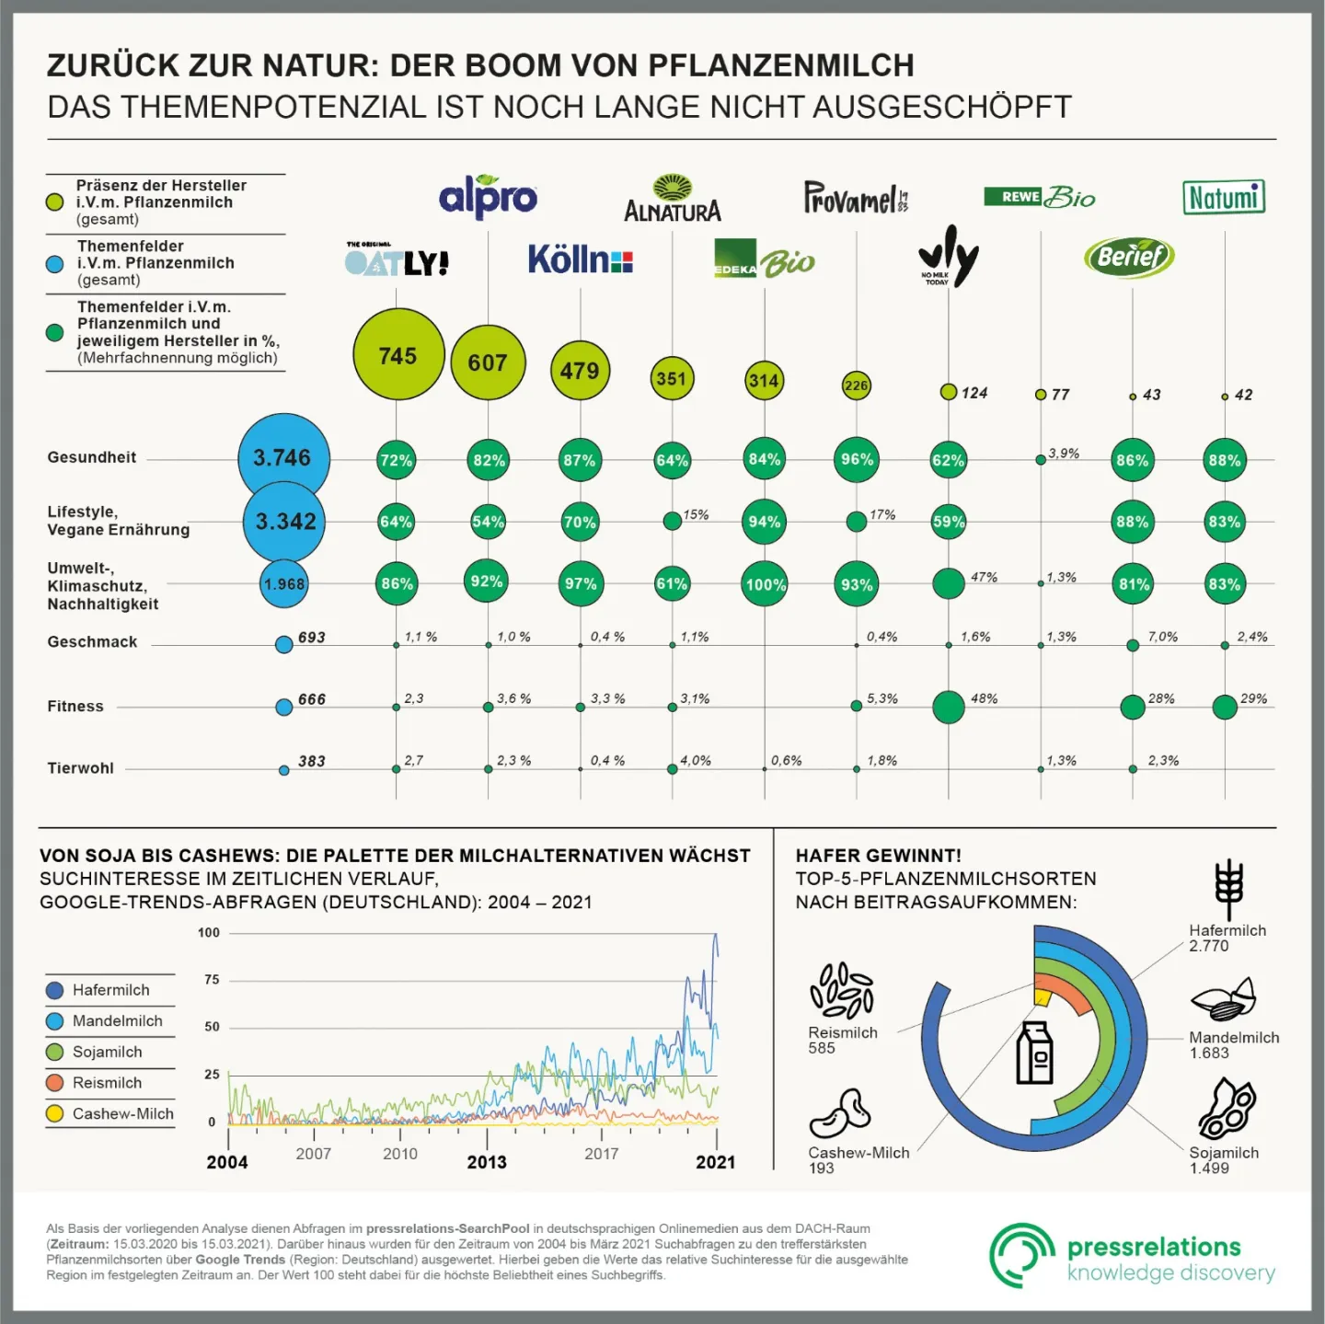
Major Milk Companies
https://prmagazin.de/zurueck-zur-natur/

Slide 45
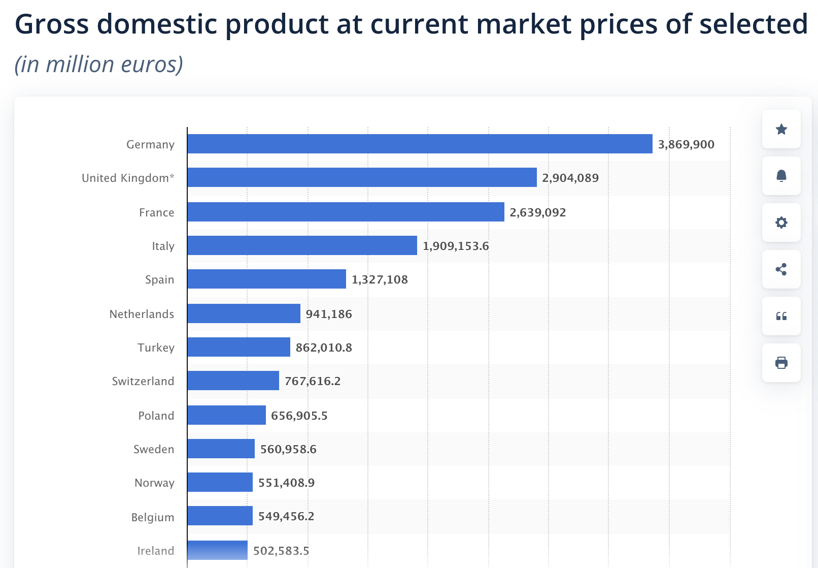
European Countries GDP

Slide 46
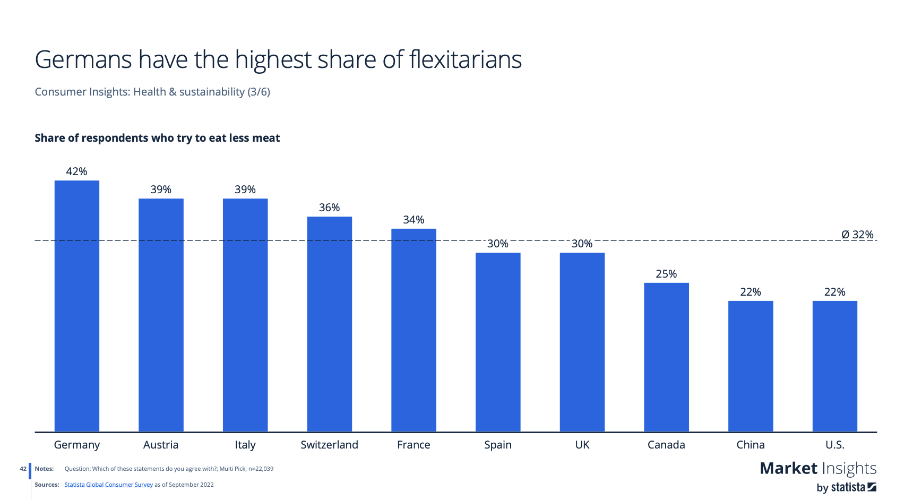
Flexitarians

Slide 47
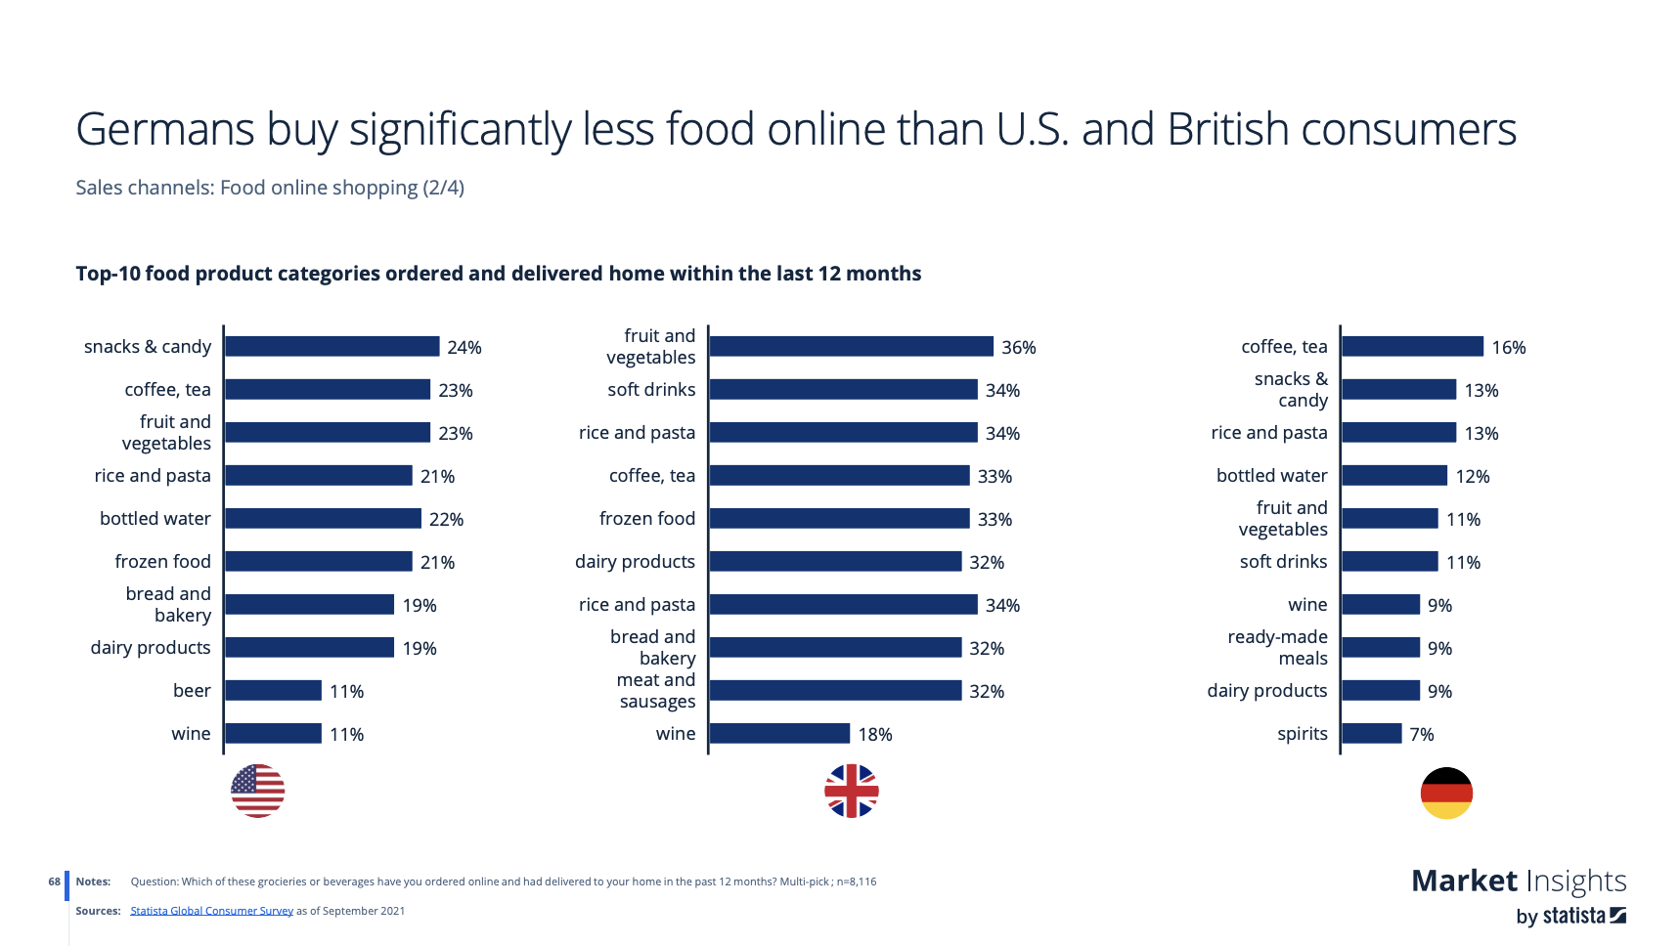
More Supermarket than online

Slide 48
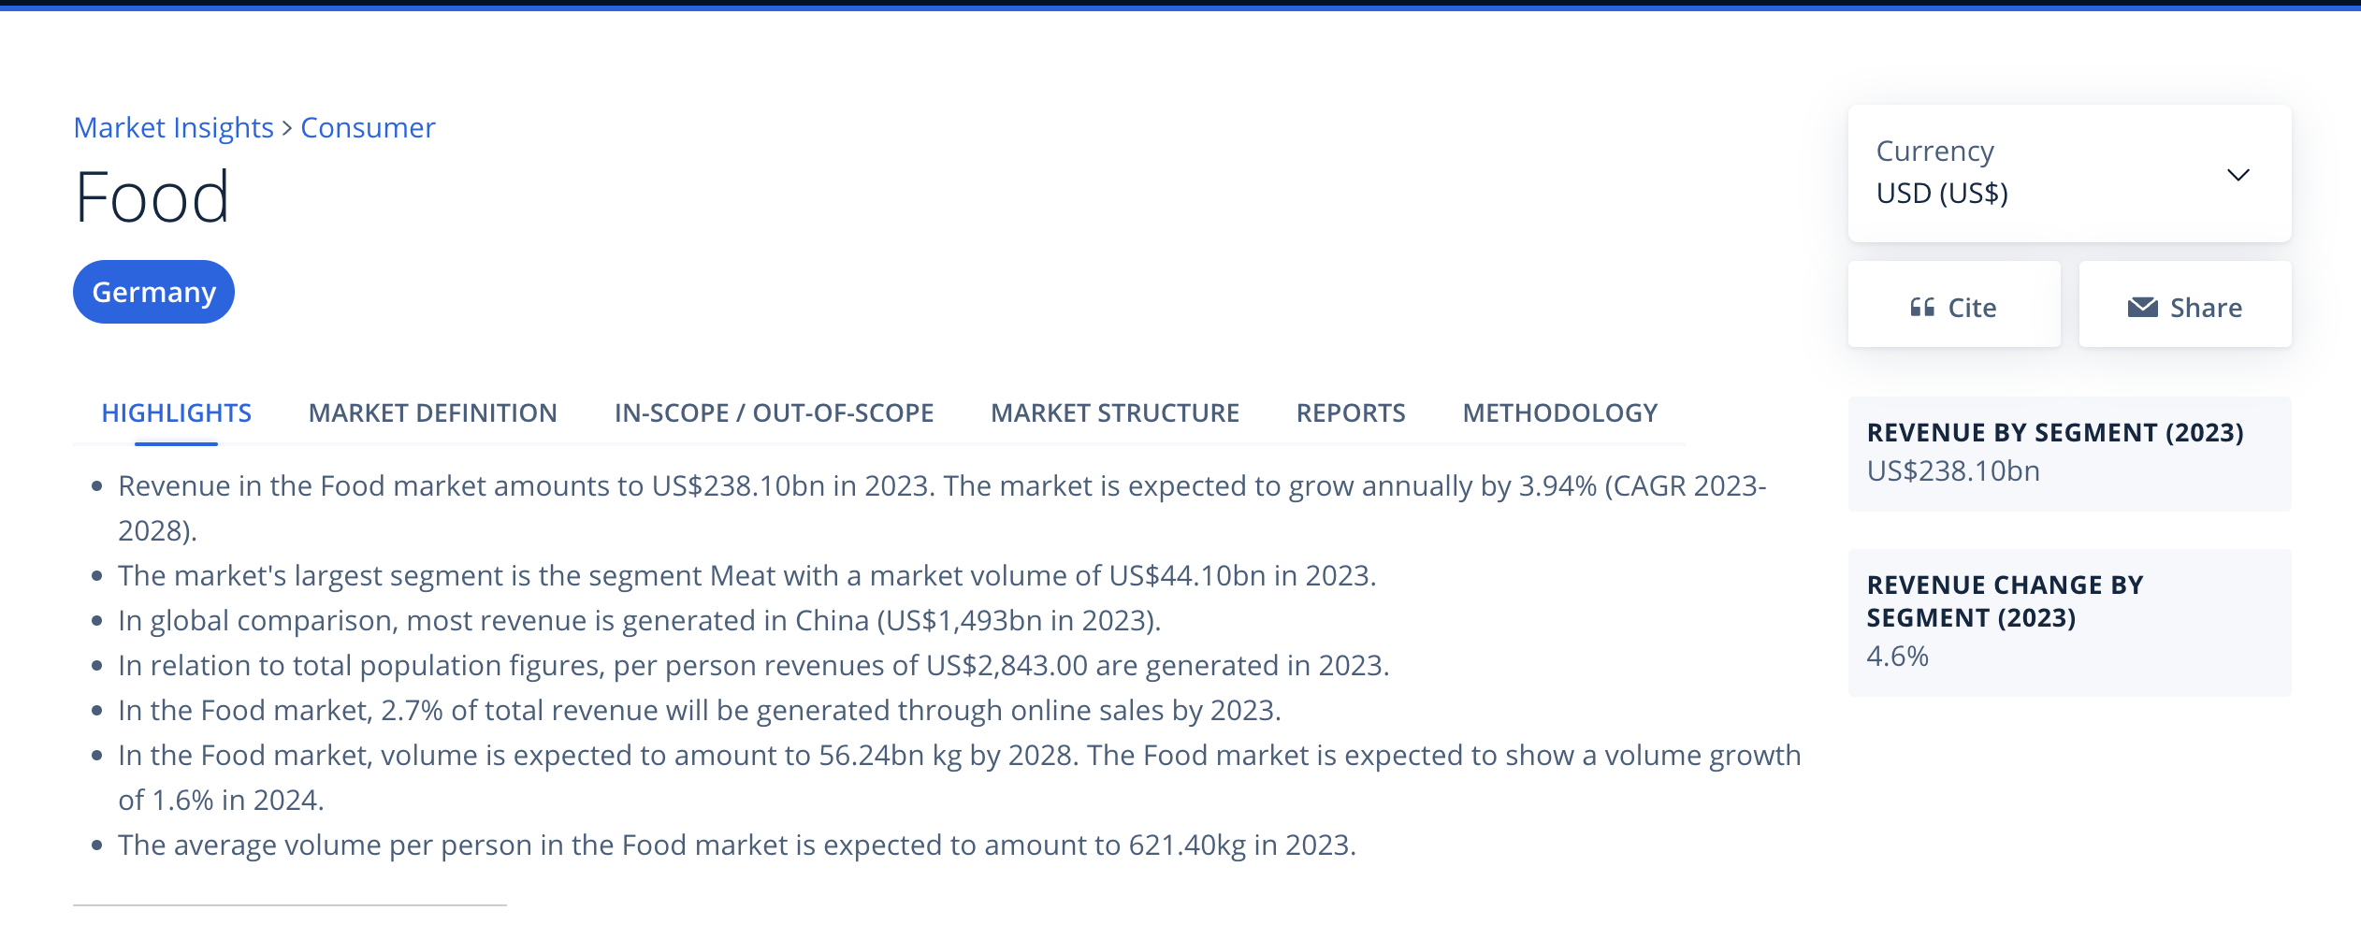
Germany Food Market size

Slide 49
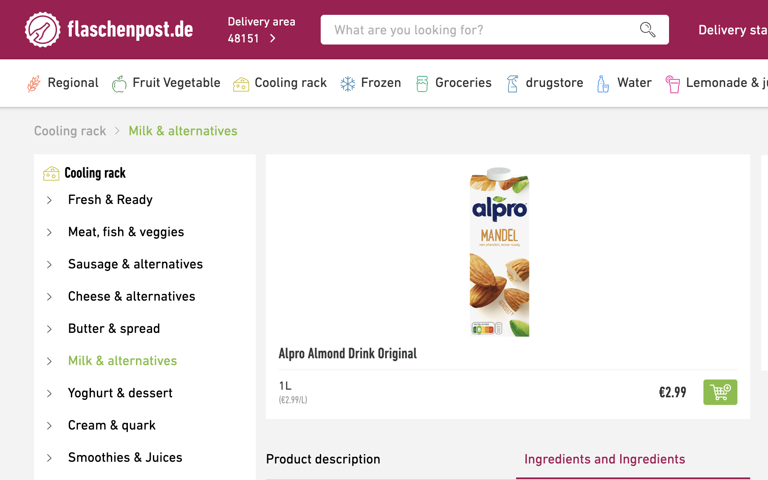
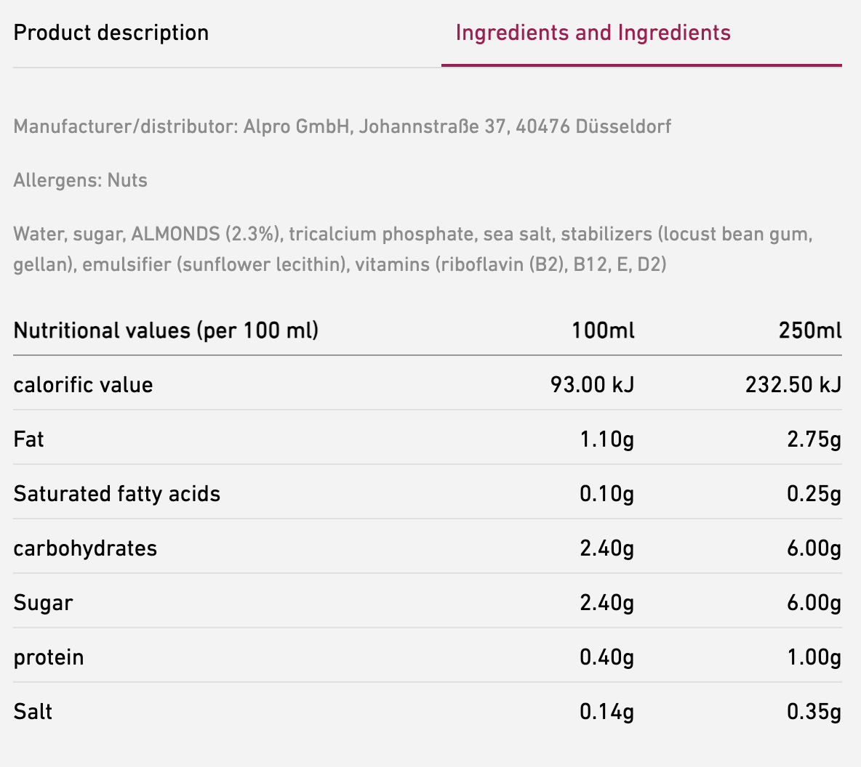
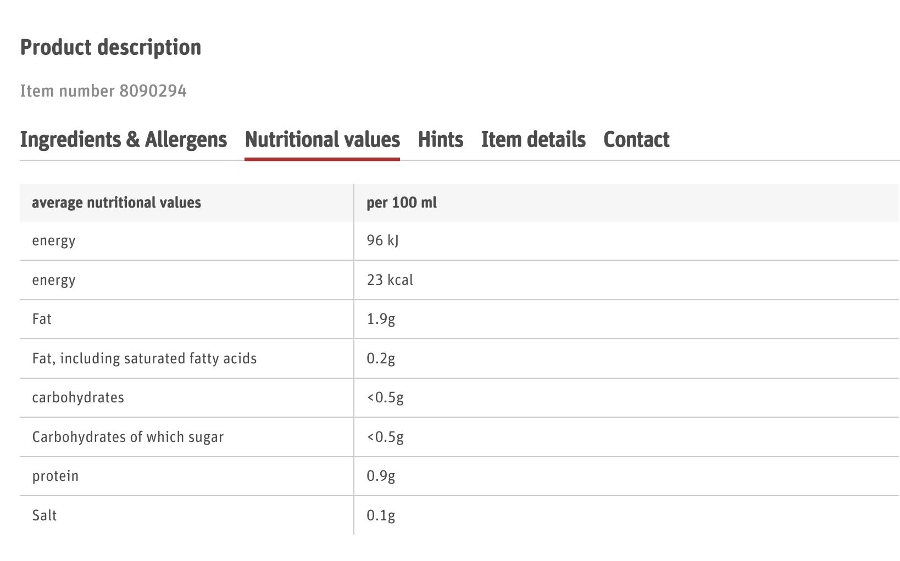
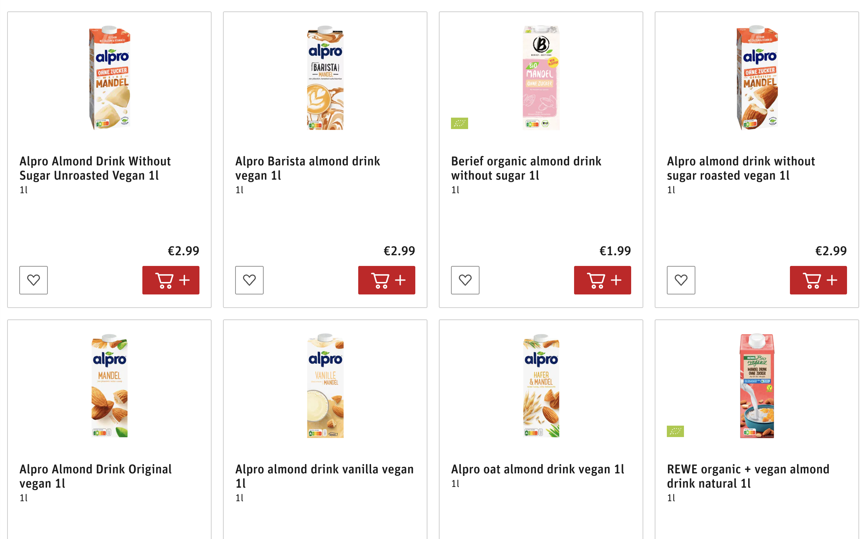
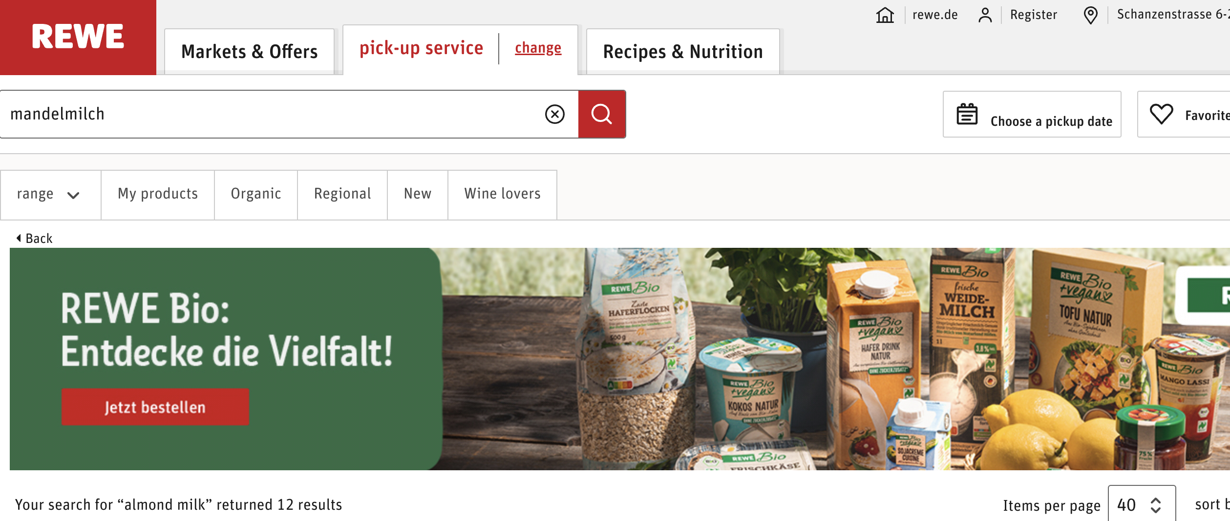
Sales Price & Nutrition Origin

